Slide 1
Lecture 7 Informed Search
CS 180 – Intelligent Systems
Dr. Victor Chen
Fall 2022

Slide 2

Informed Search

Slide 3
Informed (heuristic) Search
Idea: Use a heuristic function h(n) to rank nodes in the frontier and expand the node with the lowest h(n) value
Greedy search (Best-first search)
A* search

Slide 4
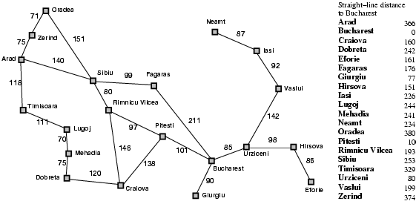
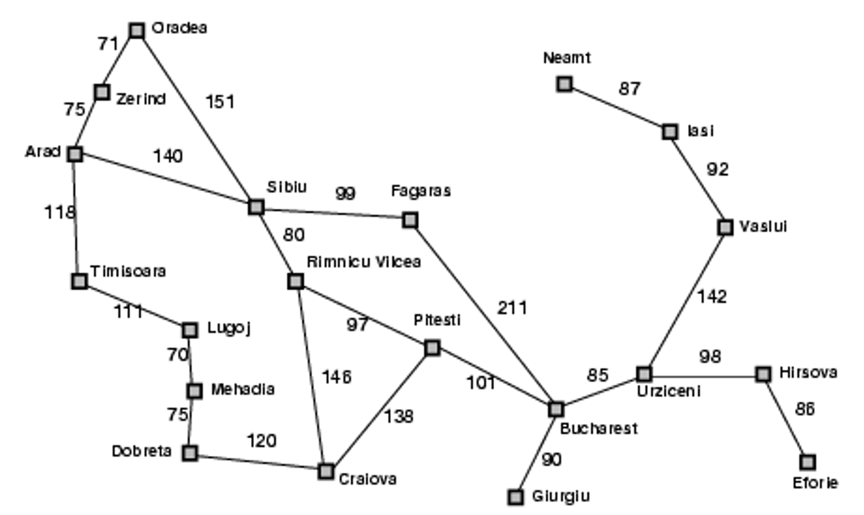
Heuristic for the Romania problem
heuristic function h(n)

Slide 5

Greedy best-first search example

Slide 6
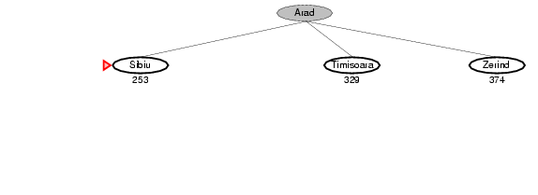
Greedy best-first search example

Slide 7
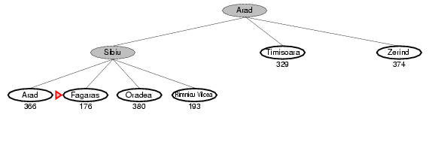
Greedy best-first search example

Slide 8
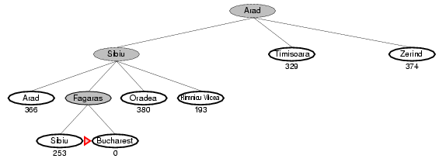
Greedy best-first search example

Slide 9
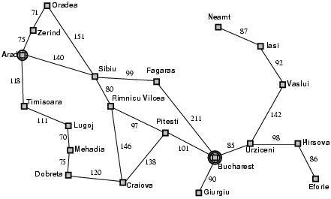
Properties of greedy search
Complete?
No – can get stuck in loops.
start
goal

Slide 10
Properties of greedy best-first search
Complete?
No – can get stuck in loops
Optimal?
No

Slide 11
Properties of greedy best-first search
Complete?
No – can get stuck in loops
Optimal?
No
Time cost?
Worst case: O(b^{m}) where b is the branching factor and m is the maximum path length
Space cost?
Worst case: O(b^{m})

Slide 12
How can we fix the greedy search?
In the Romania traveling problem, greedy search only considers the remaining distance
Idea: Keep track of the distance already traveled in addition to the distance remaining.

Slide 13
A* search
Idea: Use evaluation function f(n) to estimate the path cost from start node to goal and expand the node with the lowest f(n) value
f(n) is to estimate path cost from start node to goal:
f(n) = g(n) + h(n)
g(n): cost from start node to node n
h(n): estimated cost from node n to goal (heuristic function)
Notes:
Dates back to 1968

Slide 14

A* search example (distance already traveled + distance remaining)

Slide 15
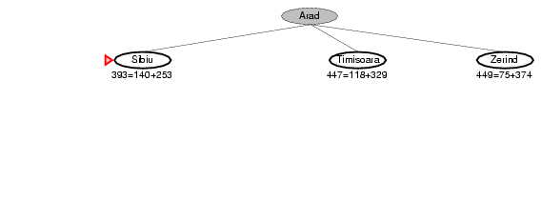
A* search example

Slide 16
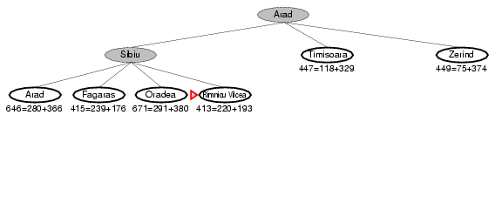
A* search example

Slide 17
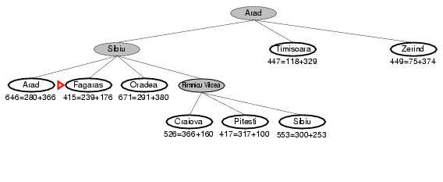
A* search example

Slide 18
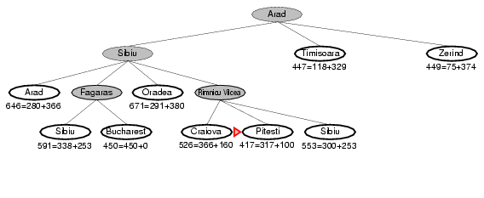
A* search example

Slide 19
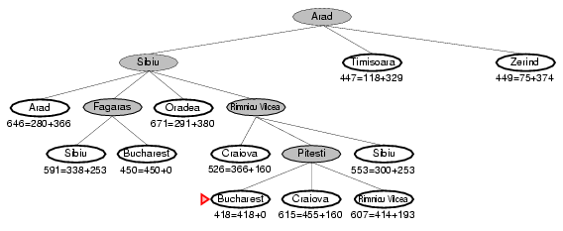
A* search example

Slide 20
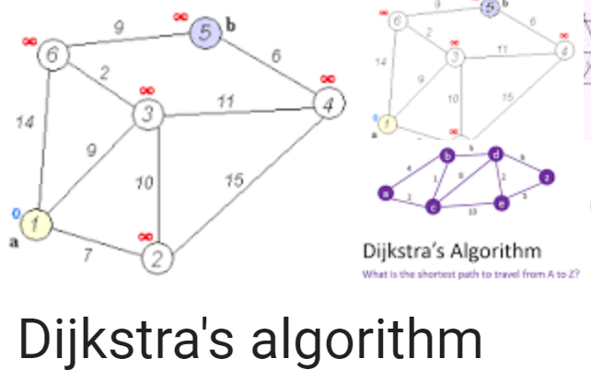
Dijkstra’s vs Greedy vs A*
Dijkstra’s algorithm order all the nodes on their g(n) values (distance already traveled).
Greedy algorithm order all the nodes on their h(n) values (distance remaining).
A* balances Dijkstra’s algorithm with greedy search by ordering all the nodes using f(n) = g(n) + h(n), which is the estimated path cost from start node through n to goal.

Slide 21
Dijkstra's vs. A* search
Source: Wikipedia

Slide 22
Is A* optimal?
Is A* is guaranteed to provide the shortest path?
Theorem: If h(n) is admissible, then A* is optimal

Slide 23
Admissible heuristic
A heuristic h(n) is admissible if for every node n, h(n) ≤ h*(n), where h(n) is the estimated cost from n to goal while h*(n) is the true cost from n to goal.
Is the distance heuristic we used before in Romanian traveling problem is admissible?
Yes. Because straight line distance never overestimates the actual road distance.

Slide 24
How to tell which heuristic is better?
If h₁ and h₂ are both admissible heuristics and h₂(n) ≥ h₁(n) for all n, then h₂ dominates h₁
Using h₂(n) will lead to expanding fewer nodes than h₁(n) .

Slide 25
Properties of A*
Complete?
Yes – Will always find a solution if one exists
Optimal?
Yes If h(n) is admissible
Time/space cost?
A* search expands every node with h(n) ≤ C*- g(n)
C* is the path cost of the optimal solution
g(n): cost from start node to node n
A higher (dominating) h(n) will have a higher pruning power

Slide 26
Search strategies
Algorithm | Complete? | Optimal? | Time complexity | Space complexity
Greedy
A*
Worst case: O(b^{m})
where b is branching factor
and m is maximum path length
No
No
Yes (if heuristic is
admissible)
Number of nodes with h(n) ≤ C*- g(n)
h(n): estimated cost from n to goal
g(n): cost from start node to n
C* is the path cost of the optimal solution
Yes

